Slide 1
Simulation Product Line Sprint 2

Slide 2
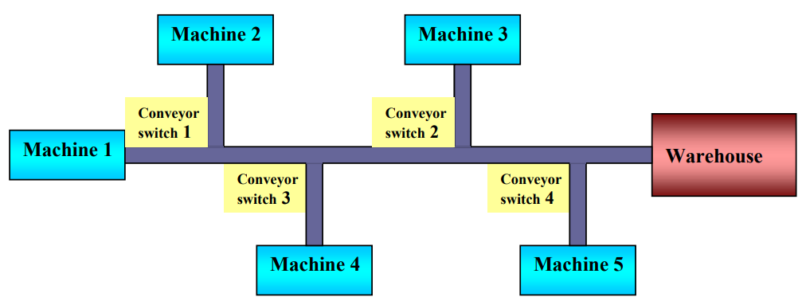
Progress
Use Case 2 : The supermarket
Complete
Use Case 3 : The transport system
Complete

Slide 3
Results
supermarket
 | Strategy 1 | Strategy 2 | Strategy 3 |  | Strategy 4 | Strategy 5
 |  |  | Groc-Count | Exp-Time
Queues
Avg Content (customers) | 3.31 | 1.33 | 4.44 | 62.65 | 1.03 | 20.38
Avg Stay (seconds) | 68.19 | 27.38 | 91.18 | 852.45 | 20.99 | 423.49
Transport system
 | Conveyor speed increase | Transfer Unit switch
Production | 2232 | 2233
Status Busy | 1.0 | 1.0
Notes:
The M/M/c queueing model is a mathematical model that describes systems where multiple servers handle the incoming tasks.

Slide 4
Gained knowledge
Basic modeling nodes
Channel manipulation
M/M/c queueing model
Poisson distribution - arrivals
Negative exponential distribution – Service time
Notes:
The M/M/c queueing model is a mathematical model that describes systems where multiple servers handle the incoming tasks.

Slide 5
Thank you
Questions?

